Slide 1
Symbioses
April 13, 2021
Figures and tables from Lambers book unless otherwise noted

Slide 2
Ice-breaker review questions
What is a symbiosis? What are the different types?
Why would a plant establish a symbiosis?
How would a scientist identify a symbiosis?
What are some examples of symbioses involving plants?

Slide 3
Today’s symbioses
Mycorrhizae
N-fixing bacteria
Fungal endophytes

Slide 4
Today’s symbioses
Mycorrhizae
N-fixing bacteria
Fungal endophytes

Slide 5
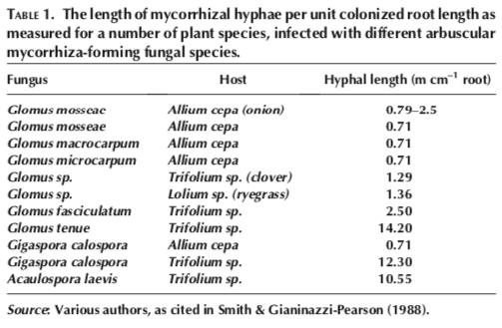
Mycorrhizae Basics
Associated with plant roots
82% of plant species
Increase root surface area
Similar to root hairs
Increase absorptive surface
Increases nutrient uptake
Primarily N and P

Slide 6
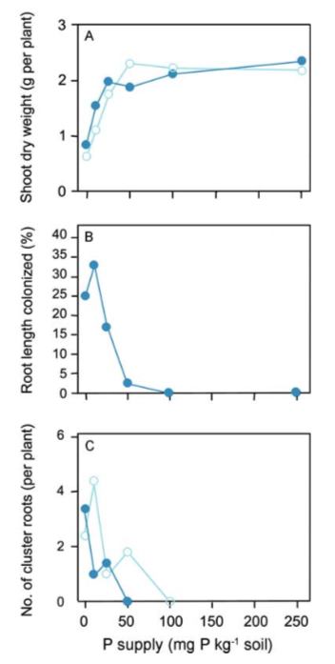
Plants help regulate the symbiosis

Slide 7
Types of Mycorrhizae
Arbuscular Mycorrhiza
Ectomycorrhiza
Ericoid Mycorrhiza
Orchid Mycorrhiza

Slide 8
Types of Mycorrhizae
Arbuscular Mycorrhiza
Ectomycorrhiza
Ericoid Mycorrhiza
Orchid Mycorrhiza

Slide 9
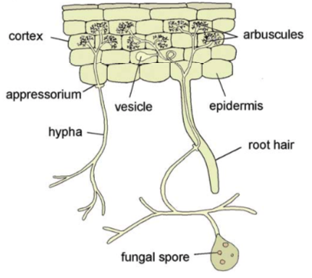
Arbuscular Mycorrhiza (AM)
Most widespread association
92% of all plant families
Trade nutrients for Carbon via arbuscules
Use vesicles for storage
Increase inorganic N and P acquisition

Slide 10
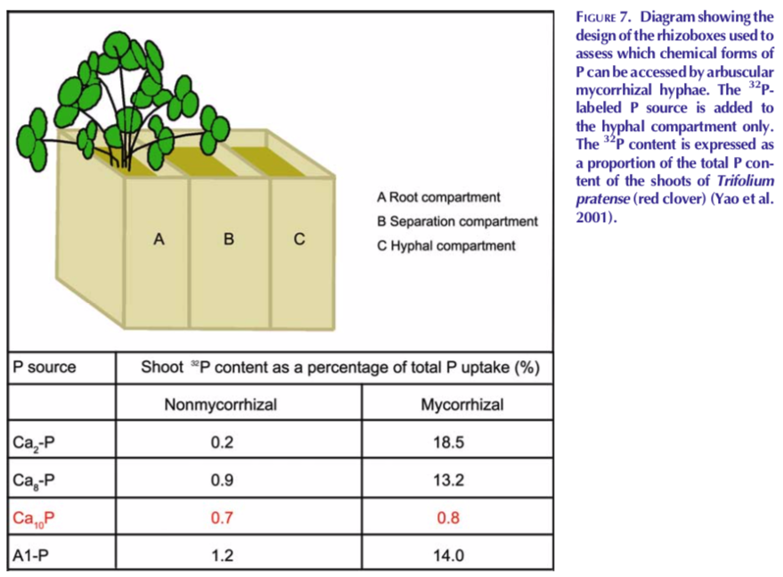
AM: Primary benefit is increased access to nutrients (not access to new nutrients)
Mycorrhizae getting more P

Slide 11
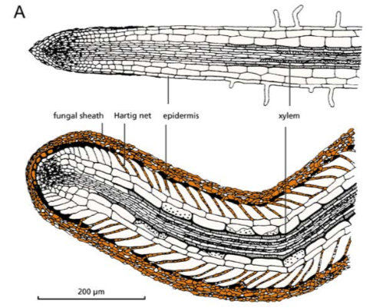
Ectomycorrhiza
Associations are more limited
Mainly trees: e.g., Pinus, Quercus, Salix, Fagus, Eucalyptus, Betula, Populus, Alnus, Fraxinus, Cupressus
Do not penetrate host cells
Exchange occurs in the intercellular spaces
Can access organic nutrient sources

Slide 12
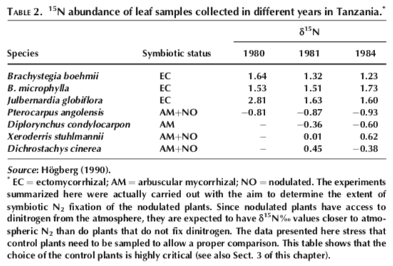
Organic vs. Inorganic nutrient acquisition
Ectomycorrhizae have different signature, suggesting acquisition from different source (organic in this case)

Slide 13
Phillips et al. (2013)

Slide 14
Phillips et al. (2013)

Slide 15
Phillips et al. (2013)

Slide 16
Phillips et al. (2013)

Slide 17
Fast-Slow
Phillips et al. (2013)

Slide 18
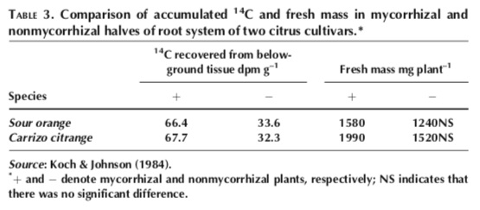
Carbon costs of mycorrhizal symbioses
4-20% of the carbon fixed by photosynthesis goes to mycorrhizae

Slide 19
Today’s symbioses
Mycorrhizae
N-fixing bacteria
Fungal endophytes

Slide 20
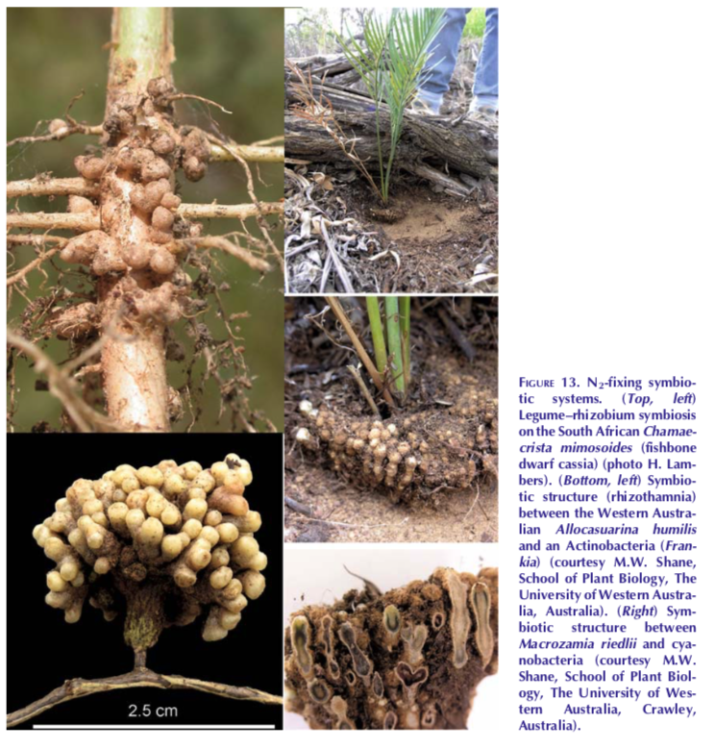
Nodule Forming Rhizobia
Convert N₂ gas into ammonia (NH₃)
Process plants can’t perform on their own
Form nodules on roots to exchange NH₃ with carbon

Slide 21
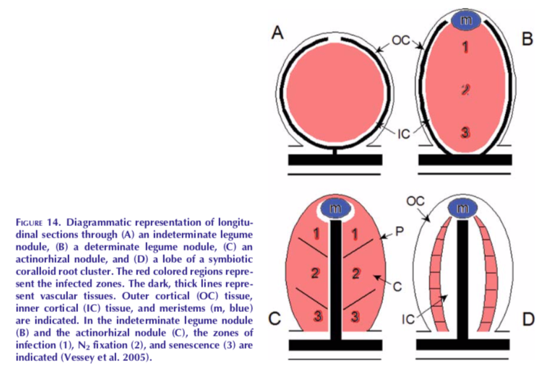
Nodule Forming Rhizobia
Bacteria; region of N fixation
Root tissue

Slide 22
Nodule Forming Rhizobia

Slide 23
Fabaceae
The legumes!
Soybean
Alfalfa
Clover
Peas
Lentils
Mesquite
Peanuts
Tamarind

Slide 24
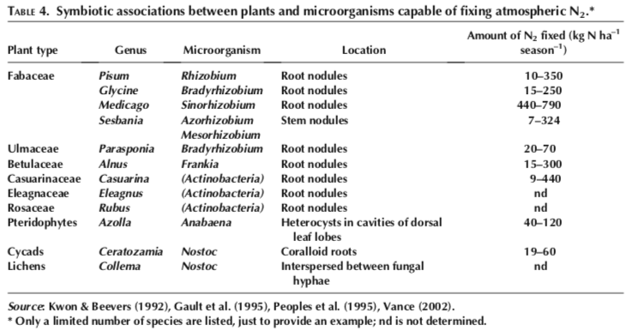
Fabaceae…and some other things

Slide 25
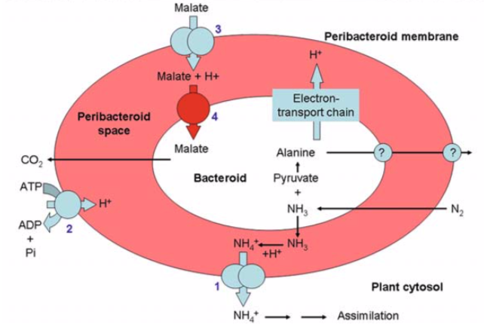
Carbon cost of the rhizobia symbiosis

Slide 26
Carbon cost of the rhizobia symbiosis
4-13% of photosynthate when soil N is high
25% or higher when soil N is low

Slide 27
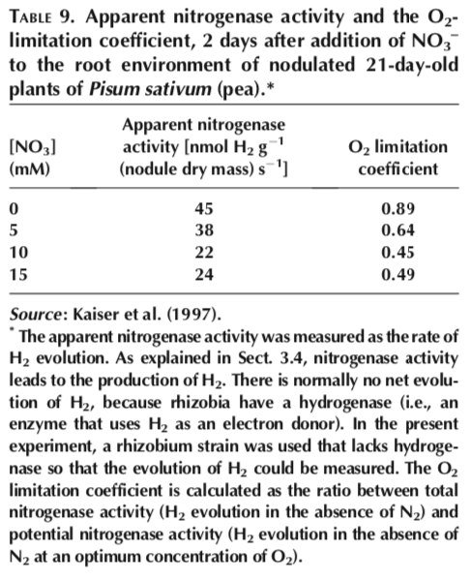
Suppression of rhizobia symbiosis
Presence of N reduces plant-mediated bacterial activity

Slide 28
Today’s symbioses
Mycorrhizae
N-fixing bacteria
Fungal endophytes

Slide 29
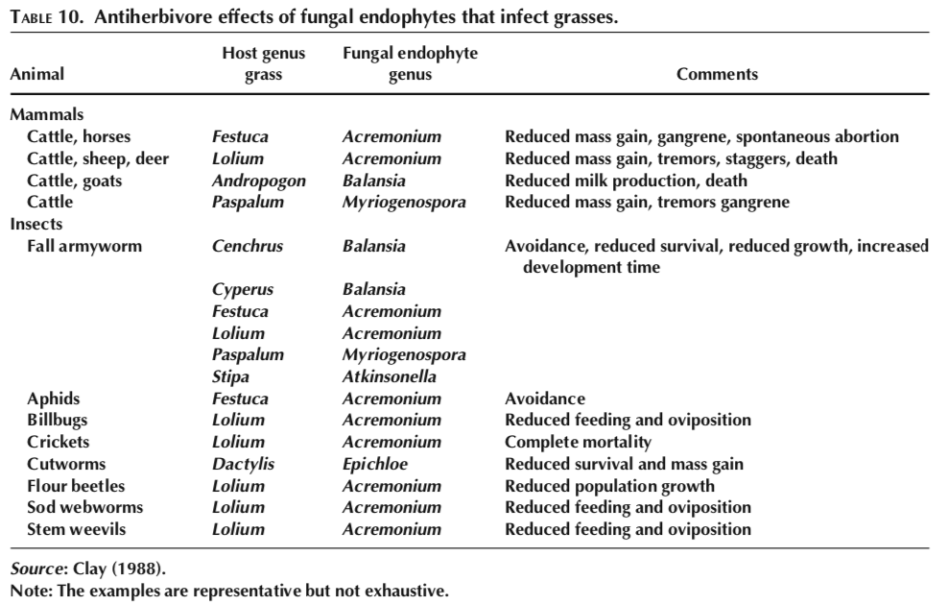
Fungal endophytes can harm herbivores

Slide 30
Fungal endophytes can increase stress tolerance
Hubbard et al. (2013)

Slide 31
Consequences for global change

Slide 32
Elevated CO₂

Slide 33
Low = low Nitrogen
High = high Nitrogen
Terrer et al. (2016)

Slide 34
Low = low Nitrogen
High = high Nitrogen
Terrer et al. (2016)

Slide 35
Low = low Nitrogen
High = high Nitrogen
Terrer et al. (2016)

Slide 36
Low = low Nitrogen
High = high Nitrogen
Why would there be a difference between AM and ECM?
Terrer et al. (2016)

Slide 37
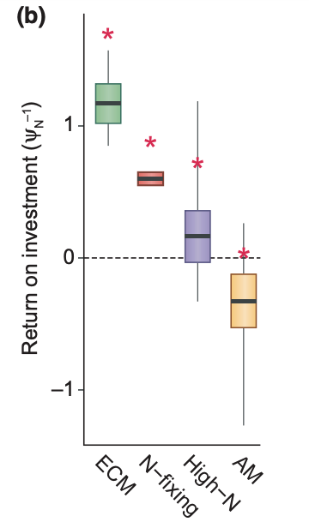
Higher N return per C invested in ECM than AM species
Terrer et al. (2018)

Slide 38
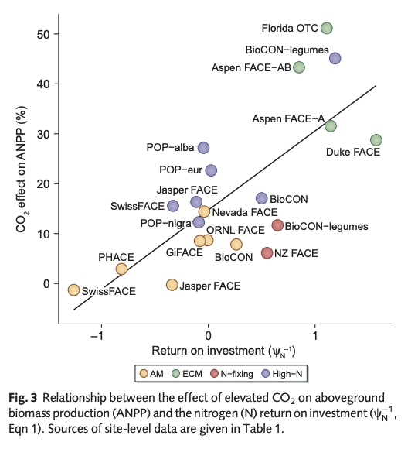
Terrer et al. (2018)

Slide 39
Global change: Nitrogen deposition

Slide 40
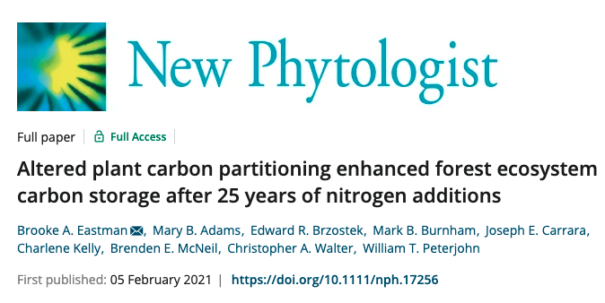

Slide 41
Add soil N reduces C cost of N acquisition, because of reduced symbiotic interaction

